Slide 1
AN IMAGE REPRESENTATION BASED CONVOLUTIONAL NETWORK FOR DNA CLASSIFICATION
Bojian Yin, Marleen Balvert, Davide Zambrano, Alexander Schönhuth and Sander M. Bohte
Presented By: Akshat Marya, Shilpa Singh

Slide 2
What is a DNA?
DNA is a long molecule made up by 4 basic elements A,C,G and T. More simply, it is a long sequence of 4 characters, that when put together in different patterns, perform different functionalities.
Each human has the same structure, but with different patterns of these units in its genomes.
Which means, we can basically pinpoint te patterns in the sequence that are responsible for specific functions, for example with diseases, more people with a particular diseases would have similar patterns in their DNA!
Obtained the full consensus first draft of human genome in 2003, it took 10 years, about 3 billion dollars. Since we don't have that kind of money.

Slide 3
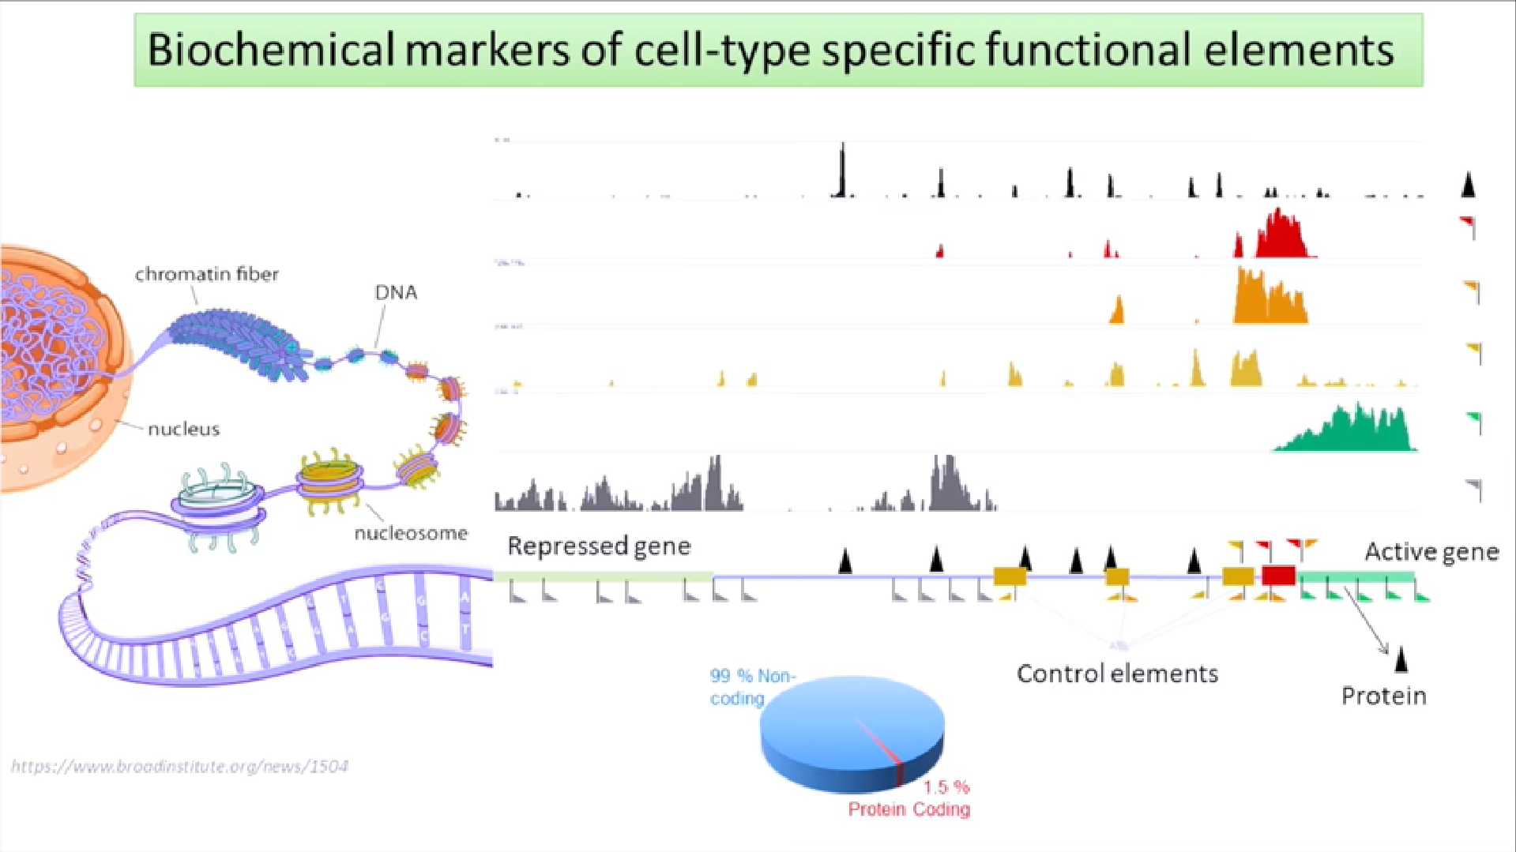
Notes:
Show the DNA in PYTHON CODE

Slide 4
Research Contributions
Predicted a chromatin state using a CNN that, in terms of architecture, resembles conventional CNNs for image classification and is designed for detecting distal relations.
Proposed a method to transform DNA sequence patches into two-dimensional image-like arrays to enhance the strengths of CNNs using space-filling curves, in particular the Hilbert curve.
DNA CODE

Slide 5
What Is a Hilbert Curve?
A space-filling whose range contains the entire 2-dimensional unit square.
A line is drawn on a 2D matrix that represents an infinite space where the line hits each point in that space, filling it completely.
Proximal elements of the sequence stay in close proximity to one another.

Slide 6
Why use Hilbert Curve for DNA?
Maps short-term sequential relationships, which are ubiquitous in DNA (such as codons, motifs or intron-exon structure.
Relates to the structure of the chromatin, which - without all details being fully understood is tightly packaged and organized in general.
To an extent the long-term interactions affecting DNA can also be mapped.

Slide 7
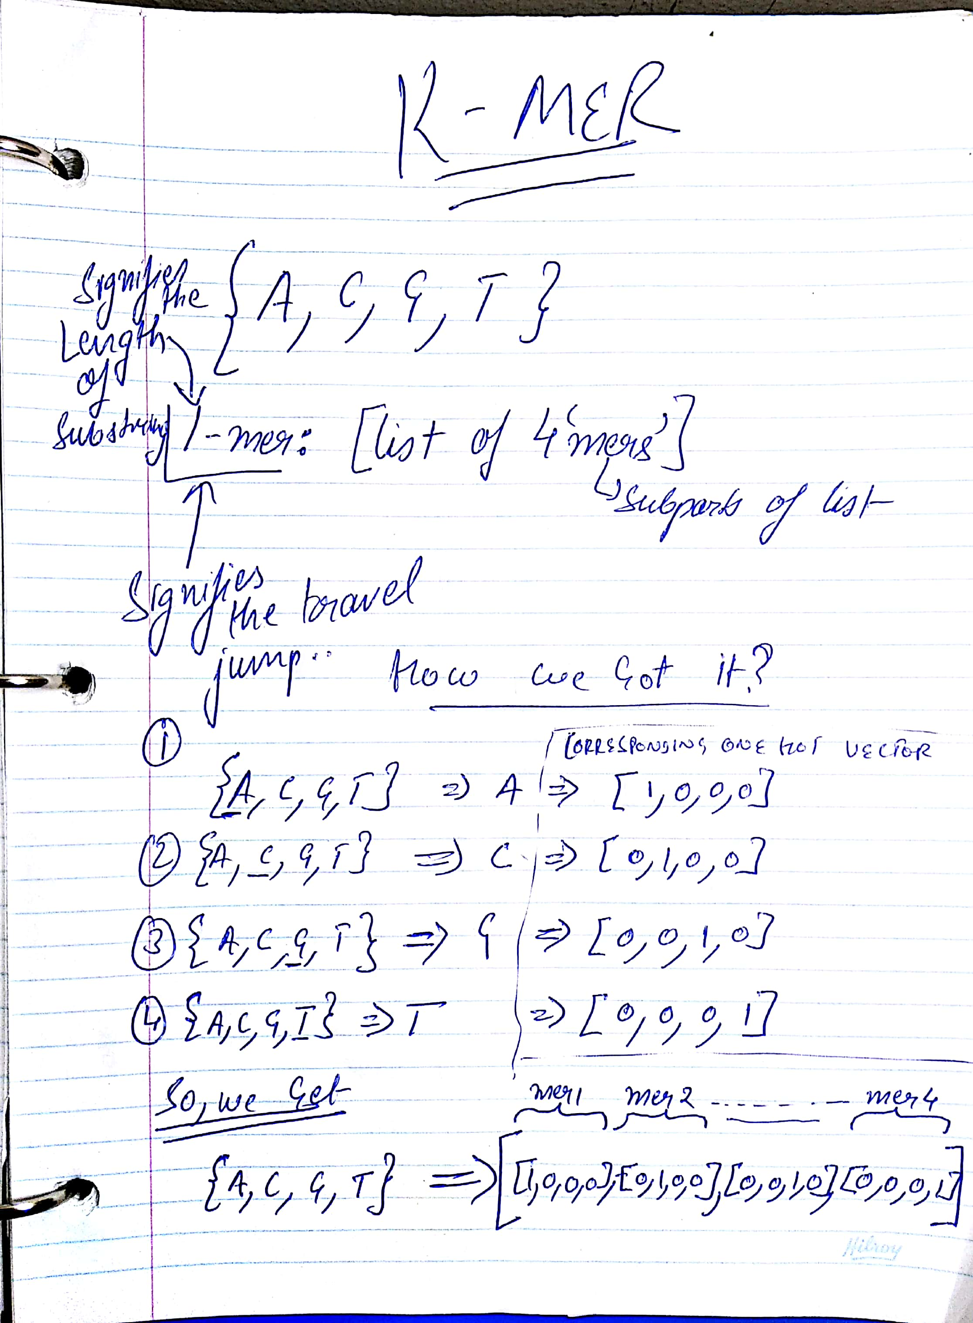
DNA Sequence Representation
Represented a DNA sequence as a list of k-mers.
Transformed each k-mer into a one-hot vector, which results in the sequence being represented as a list of one-hot vectors.
Created an image with each pixel in the generated image as one-hot vector representing a k-mer using Hilbert curves.
Each pixel is assigned a one-hot vector of length of 4^4 i.e. 256
Notes:
SHOW THE CODE

Slide 8
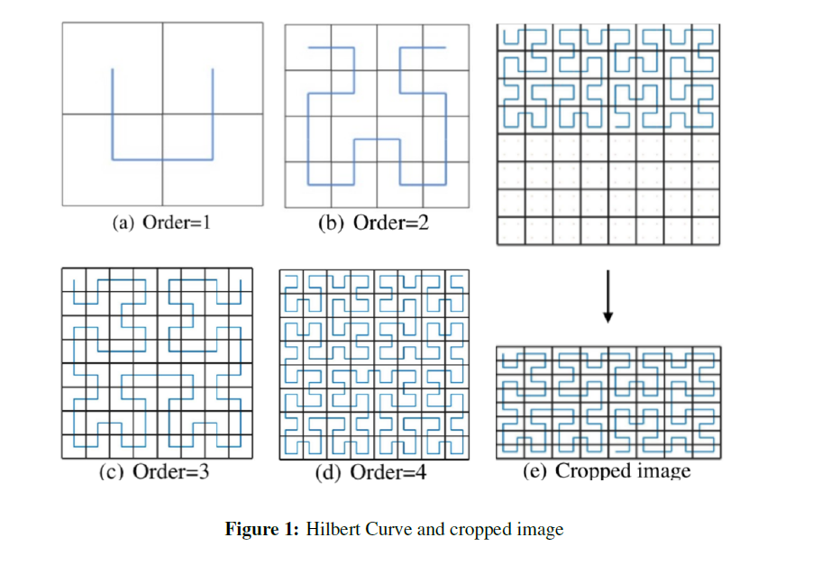
DNA Sequence Representation
k = 4 yields the best performance; lower values for k result in reduced accuracy, while higher values yield a high risk of overfitting.
Hilbert curve yields a square image of size 2^n * 2^n, where n is the order of the curve.
Used a Hilbert curve of order 5, resulting in an image of dimensions 2^5 *2^5 * 256 = 32 *32 *256
DNA sequence does not necessarily have 2^n * 2^n k-mers.
Almost half of the resulting 1024 pixels are filled so removed the empty half of the image and end up with an image of size 16*32*25
Notes:
SHOW THE CODE
Each pixel in the generated image is assigned a one-hot vector representing a k-mer. For increasing k, the length of the vect or and thus the image dimension increases. Here, we use k = 4 resulting in 256 channels, which implies that each channel contains very sparse information

Slide 9
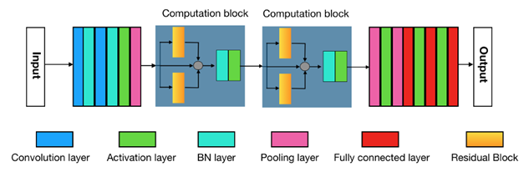
Network Architecture
First Part of Network:
* Reduces the sparseness of the input image of DNA
*Consists of the consecutive layers [c; bn; c; bn; af; p].
Main Body of Network: *Enhances the ability of CNN to extract the relevant features from DNA space-filling curves
*Uses the Computational Block inspired by the ResNet residual blocks.
Last Part of Network:
*Consists of 3 fully-connected layers
*Softmax is used to obtain the output classification label.
Notes:
The datasets contain DNA subsequences with a length of 500 base pairs. Each sequence is labeled either as “positive” or “negative”, indicating whether or not the subsequence contains regions that are wrapped around a histone protein

Slide 10
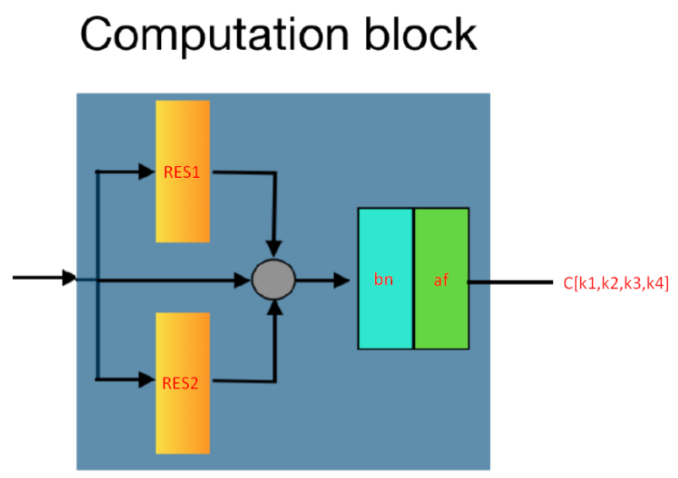
Computational Block
The computational block has 4 convolutional layers, two in each Residual Block.
The outputs of two Residual Blocks and one identity mapping are summed, followed by a bn and an af layer.
Denoted C[k1;k2;k3;k4] with the two residual blocks defined as Residual1[k1;k2] and Residual2[k3;k4]
kj and kj+1 are the respective filter sizes of the two convolutional layers.

Slide 11
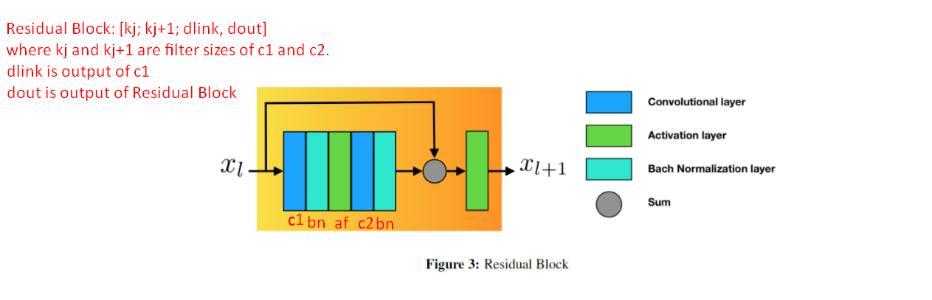
Residual Block
The Residual Block first computes the composite function of five consecutive layers followed by the concatenation of the output with the input tensor
The Residual Block is denoted by Residuall[kj;kj+1;dlink;dout]
Here, dlink and dout are the dimensions of the outputs

Slide 12
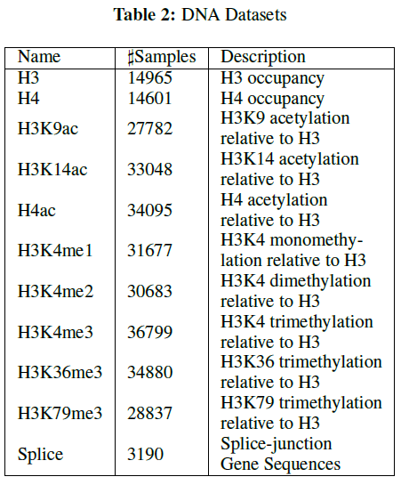
Dataset
10 datasets about DNA sequences wrapping around histone proteins.
“H3” or “H4” indicates the histone.
In each dataset, samples are sequences with length of 500 base pairs
Samples in “Positive” class contain regions wrapping around histone proteins and vice versa.
With these datasets, if we could predict histone profiles from sequences with a certain level of accuracy we might help to understand about expression pattern of genes.

Slide 13
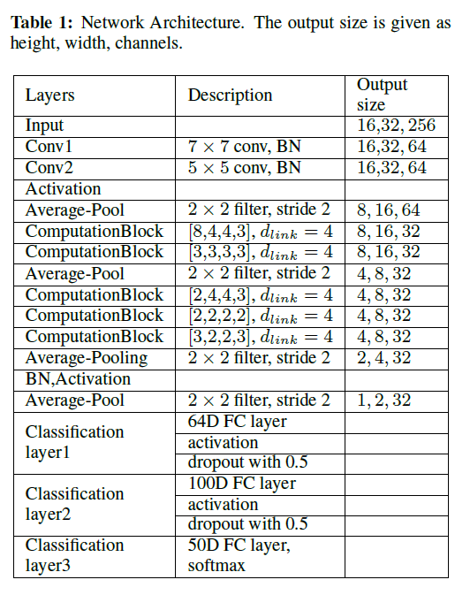
Network Architecture

Slide 14
Experiments
Train the network using the AdamOptimizer in which a learning rate is maintained for each network weight (parameter) and separately adapted as learning unfolds
Learning rate: 0.003; Batch-size: 300; Maximum number of epochs: 10
Use early stopping to prevent overfitting by combining the generalization measurement and the No-Improvement-In-N-Steps(Nii-N) method.

Slide 15
Implementation Details
Exponential Linear Units is used as activation function to reduce the effect of gradient vanishing.
Average pooling outperformed Max pooling in terms of prediction accuracy by more than 2% in general, as it reduces the high variance of the sparse generated images.
Cross Entropy is used as Loss function

Slide 16
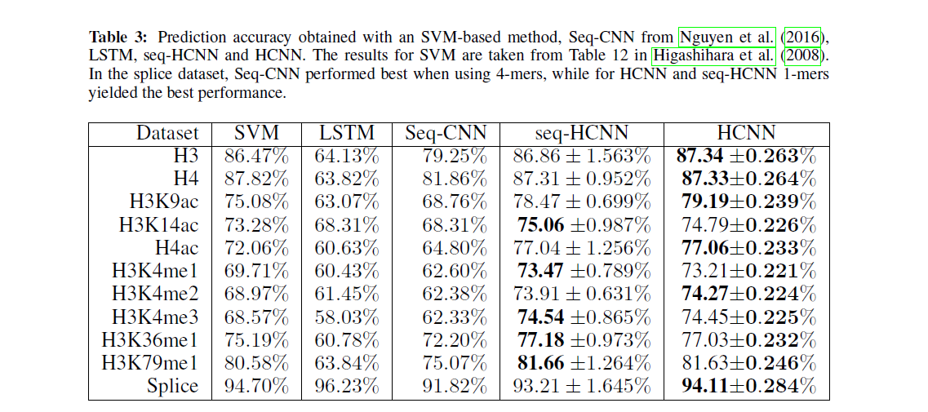
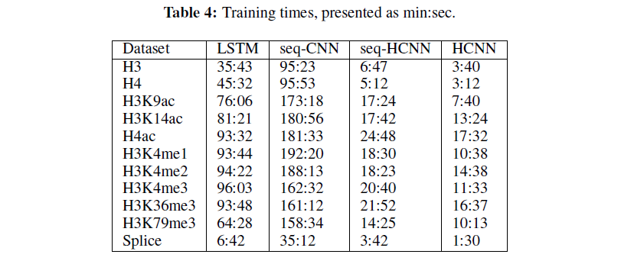
Results

Slide 17
Conclusion
Showed that representing DNA-sequences with 2D images using Hilbert curves improves precision and reduced the training time as compared to a 1D-sequence representation
The network uses larger convolutional filters, also allowing the model to detect long-distance interactions.
The use of a two-dimensional input further enhances the model’s capabilities of incorporating long-term interactions.
If we could predict histone profiles from DNA sequences with a certain level of accuracy we might help to understand about expression pattern of genes.

Slide 18
Questions?

